Slide 1
MSBD5002 Research Project
Detecting and Reducing Hallucinations in Factual Question Answering
Group 12

Slide 2
Background
Fan

Slide 3
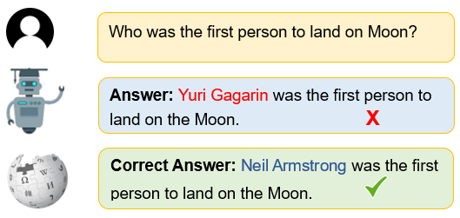




Detecting and Reducing Factual Hallucinations
Detecting and reducing hallucinations is growing in importance for:
Fan

Slide 4
Related Work
“On Early Detection of Hallucinations in Factual Question Answering” Ben Snyder, Marius Moisescu, Muhammad Bilal Zafar
https://arxiv.org/abs/2312.14183
Fan

Slide 5
Detecting Hallucinations (Implementation)
Fan

Slide 6
Dataset & Model - Overview
In the paper, authors used TriviaQA dataset, T-Rex dataset
We selected TriviaQA for this project.
Authors used multiple LLM model of different size-based in the paper, like OpenLLaMA (LAM) - 7B, LAM-13B, Falcon (FAL) - 7B, etc.
We picked OpenLLaMA-7B due to the resource limitation
Fan

Slide 7
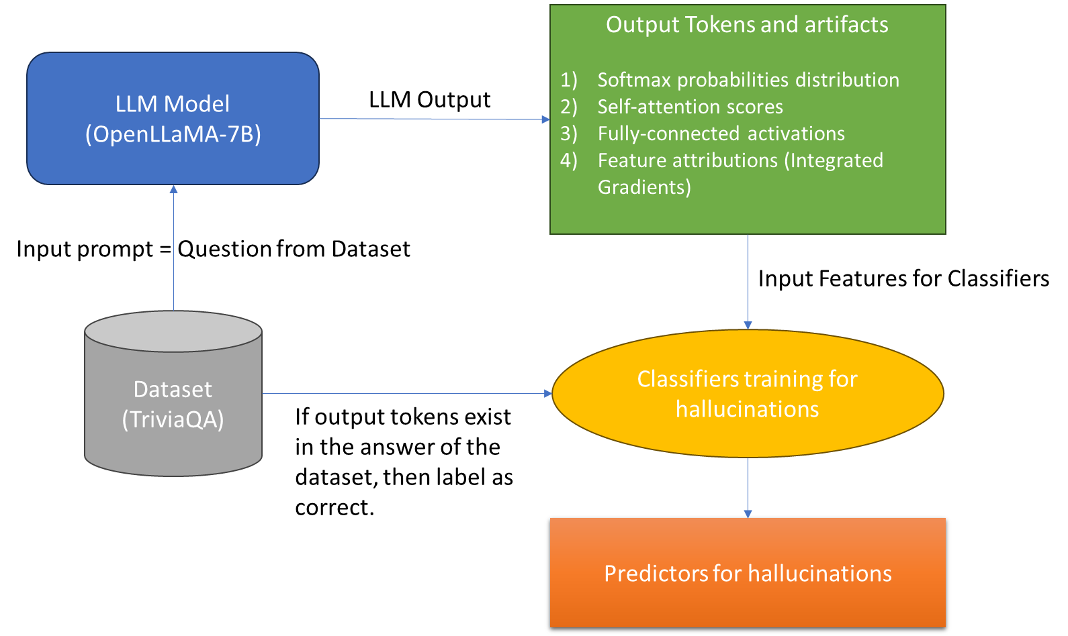
Workflow of the implementation
Fan

Slide 8
Dataset & Model - TriviaQA
Question (TriviaQA) | Answer (TriviaQA) | Response (LLM) | Correct (False is hallucination)
“From which country did Angola achieve independence in 1975?” | [‘Portogało’,’PORTUGAL’,’Portugal’,’portugual’,...] | “Which of the following is not a member of the Commonwealth of Nations?” | False
“Which prince is Queen Elizabeth II's youngest son?” | ['Eadweard', 'Edward', 'eadweard', 'edward', 'Edward', 'edward'] | “Prince Edward, Earl of Wessex” | True
“What day of the week was the Wall Street Crash?” | ["Thor's Day", 'Guruvaar', 'Thursday', 'thursday'...] | “The Wall Street Crash occurred on a Tuesday.” | False
Fan

Slide 9
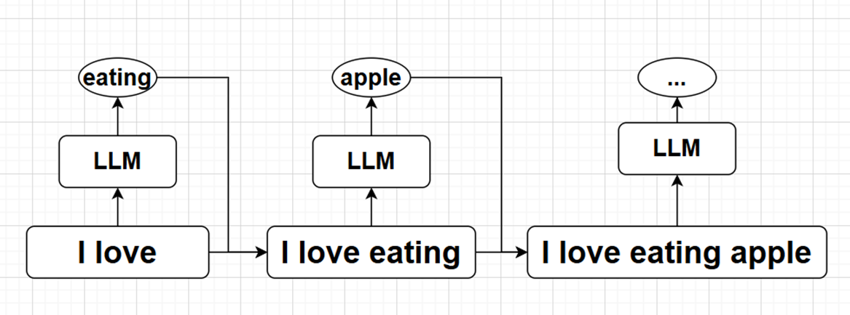
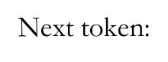
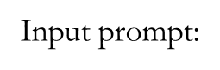
Openllama - 7b
Autoregressive LLM:
Fan

Slide 10
Four model artifacts from the paper
Softmax probabilities
Self-attention scores
Fully-connected activations
Feature attributions (Integrated Gradients)
Fan

Slide 11
Softmax probabilities - Overview
OpenLLaMA-7B has 32k token size. If an output has 40 words/token, then each word is selected from 32000 tokens by the highest softmax probabilities. So in one output sequence has 40x32000 softmax probabilities.
 | Token 1 | Token 2 | Token 3 | … | Token 32000
Output Token 1 | 0.01 | 0.005 | 0.2 |  | 0.001
Output Token 2 | 0.001 | 0.1 | 0.002 |  | 0.04
…
Output Token 40 | 0.2 | 0.001 | 0.1 |  | 0.02
Fan

Slide 12
Softmax probabilities - Overview
For hallucination classification, we focus on the “first generation” token of the output. It is the token at “start_pos” in output sequence. We take 300 output from OpenLLaMA-7B model. So we have:
 | Hallucination | First Generation Token softmax distribution (array of 32k) | … | Entropy on softmax distribution
Sample 1 | True | [0.001, 0.05, 0.1 …. 0.02] |  | 3.11
Sample 2 | False | [0.01, 0.2, 0.01 …. 0.04] |  | 4.33
…
Sample 300 | True | [0.1, 0.02, 0.04 …. 0.06] |  | 1.94
Fan

Slide 13
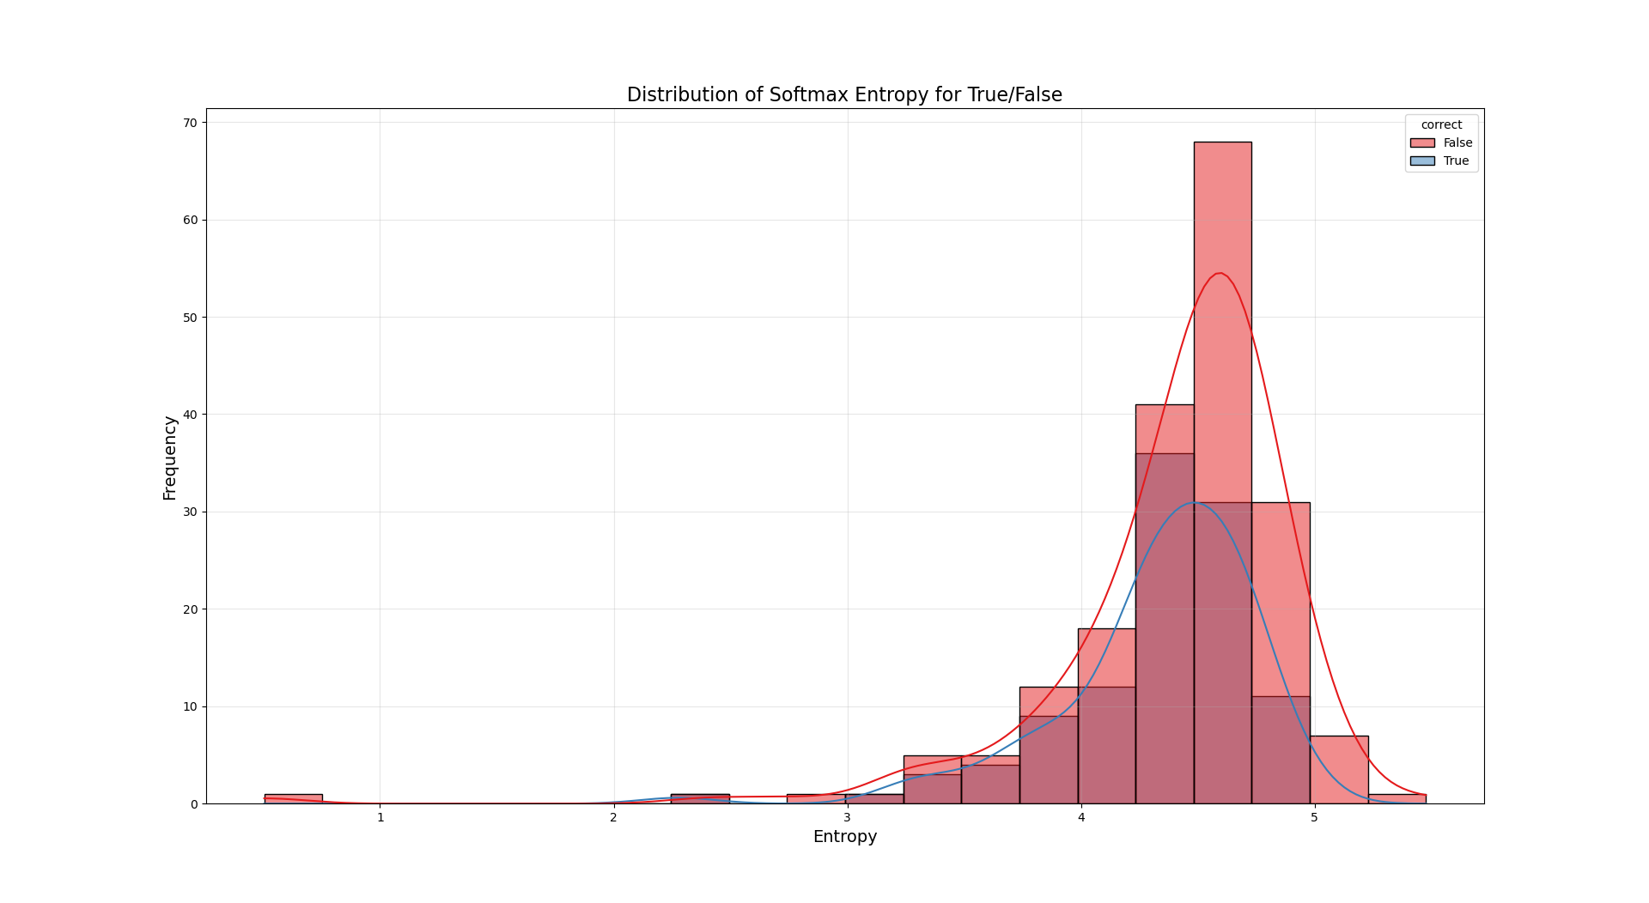
Softmax probabilities - Claim validation
Whether there is a difference in entropy distribution of first token generation when hallucination occurs?
Fan

Slide 14
Softmax probabilities - Claim validation
T-test for entropy values on 2 groups - Hallucination True vs False: p=0.115 > 0.05
(insignificant, but distribution is unlikely normal)
Mann–Whitney U test for non-normal distribution:
Results suggest that there is relationship: when hallucination is true, the softmax probabilities entropy is less.
Mann–Whitney U test | p-values
2-sides | 0.00946 < 0.05
Group True < Group False | 0.00473 < 0.05
Group True > Group False | 0.995
Fan

Slide 15
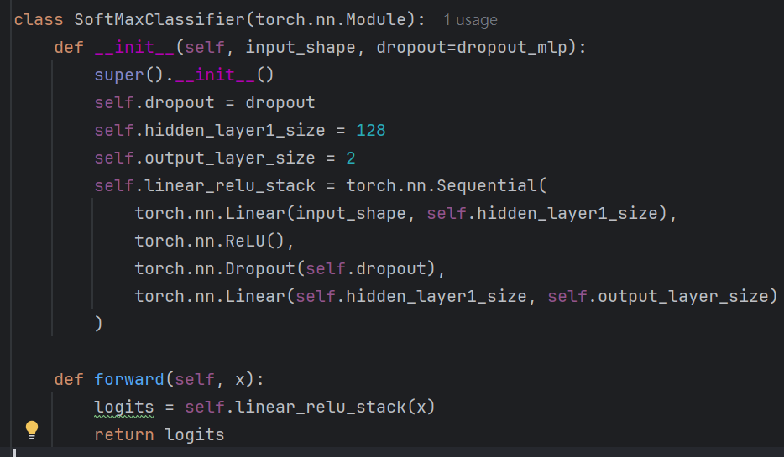
Softmax probabilities - implementation results
Input features = 32000 softmax probabilities values. Output = Softmax probabilities of 2 classes (True/False)
Sample size = 300. True 36%, False 64%
We build a neuron-network based classifier:
Architectures | AUROC | Accuracy
1 Hidden Layer 128 | 0.55-0.66 | 0.63-0.70
1 Hidden Layer 256 | 0.56-0.65 | 0.63-0.65
1 Hidden Layer 1024 | 0.55-0.65 | 0.60-0.67
2 Hidden Layer 1024, 256 | 0.51-0.60 | 0.58-0.65
2 Hidden Layer 2048, 512 | 0.54-0.60 | 0.55-0.58
Fan

Slide 16
Self-Attention
How importance of each token in a sequence relative to the other tokens?
CHENG Kit Shun

Slide 17
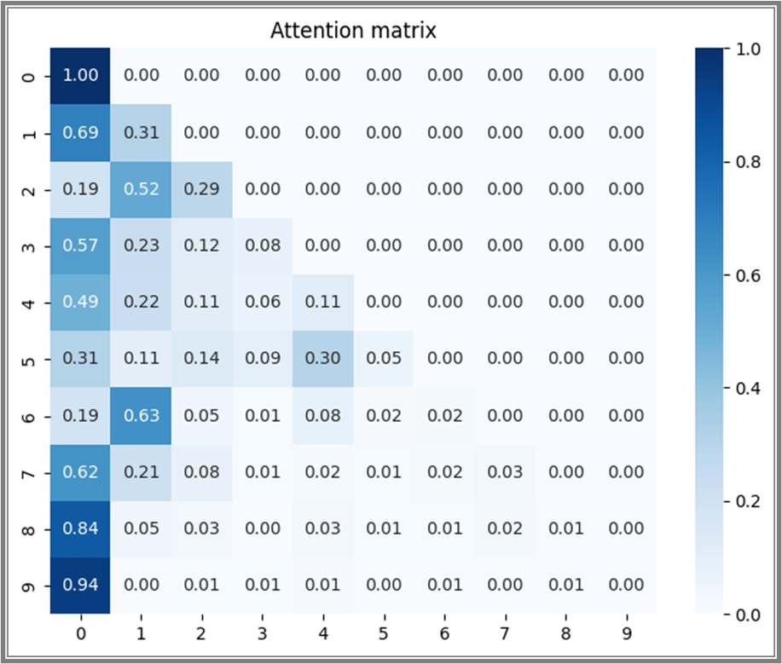
Self-Attention
CHENG Kit Shun
prompt = 'What is the capital of Japan?’, next token = “Tokyo”

Slide 18


Self-Attention Author’s idea
Get the attention score between the last token of the input and first token of the output (Last layer)
Final prompt: (prompt after prediction)
“What is the capital of Japan? Tokyo is the capital of Japan. <stop>”
CHENG Kit Shun

Slide 19
Self-Attention Author’s idea
Final prompt: (prompt after prediction)
“What is the capital of Japan? Tokyo is the capital of Japan. <stop>”
Get the final prompt
Retrieve the attention of entire final prompt (length 13)
Extract the 8th element
CHENG Kit Shun

Slide 20
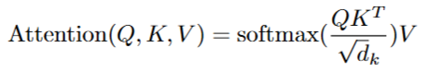
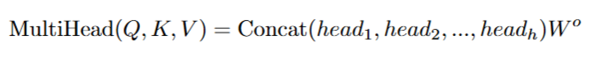
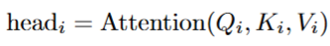
Self-Attention
What artifact does the author extract?
In OpenLLaMA 7b, it extended the attention into multi-head attention (h = 32)
Formula for attention:
Multi-head attention:
with
CHENG Kit Shun

Slide 21
Self-Attention
Formula for attention:
Multi-head attention:
with
Extracted by Author
It is in dim 4096 (hidden dim of openllama 7b)
CHENG Kit Shun

Slide 22
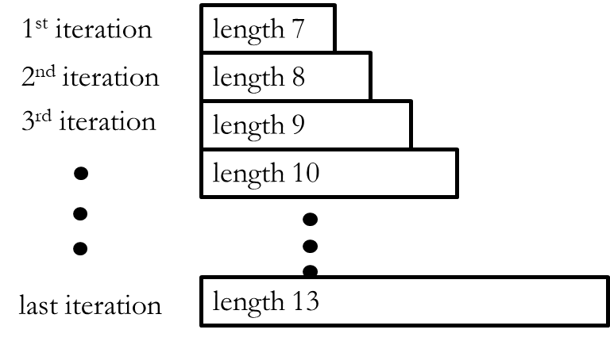
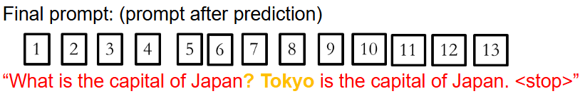
Self-Attention Author’s Implementation
Since the model is autoregressive, its attention array:
Multihead Attention in dim 4096
8th
CHENG Kit Shun

Slide 23
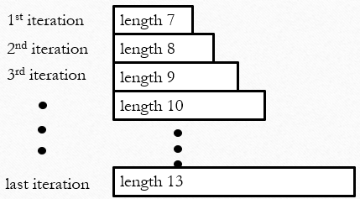
Self-Attention My implementation
Stop here!!!
Set the max-length = 2
CHENG Kit Shun

Slide 24
Self-Attention My implementation
Instead of using the final score (Multihead attention),
I use
2. Extract the element in the attention matrix
Index 8 -> last token of input
Index 9 -> first token of output
CHENG Kit Shun

Slide 25
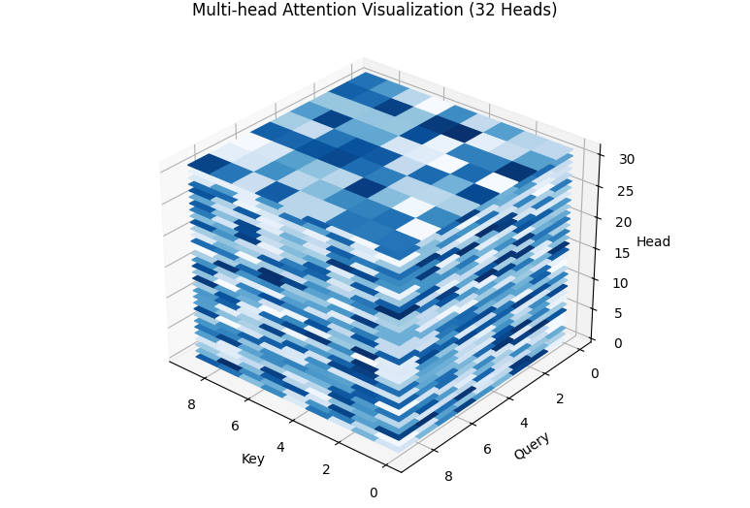
Self-Attention My implementation
It is in dim 32 since there are 32 heads
CHENG Kit Shun

Slide 26
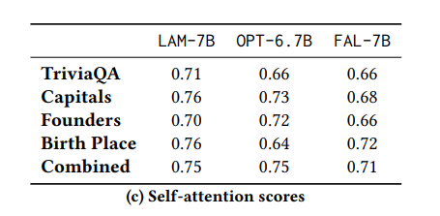
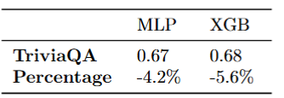
Self-Attention Statistic
My result
Author’s result
CHENG Kit Shun

Slide 27
My implementation
Advantages:
Reduce the computational time in extracting the artifact
=> 18 mins vs 241 mins for 9000 prompts
Reduce the complexity of the task
=> lower dimension (32 vs 4096)
More suitable for re-prompting
Disadvantages:
Unstable in comparison with the author’s artifact
13.4 times better!
Less than 1%
CHENG Kit Shun

Slide 28
Fully-connected activations
Same idea: get the artifact between last token of input and first token of output
Author’s implementation:
Get the final prompt
Retrieve the activation score of entire final prompt (length 13)
Extract the 8th element
CHENG Kit Shun

Slide 29
Fully-connected activations
My implementation:
Stop at second iteration
Retrieve the activation score in the second iteration
Extract the last element
CHENG Kit Shun

Slide 30
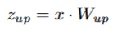
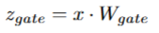
Fully-connected activations
Up projection:
Size 11008
Gate projection:
Size 11008
W_down is a projection matrix from dim 11008 to dim 4096
Author extracts the up projection (dim 11008) and I extract the MLP output (dim 4096)
CHENG Kit Shun

Slide 31
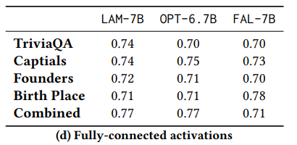
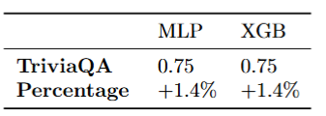
Fully-connected activations
My result
Author’s result
CHENG Kit Shun

Slide 32
My implementation
Advantages:
Reduce the computational time in extracting the artifact
Reduce the complexity of the classifier (lower dimension 4096 vs 11008)
More suitable for re-prompting
Disadvantages:
Unstable in comparison with the author’s artifact
CHENG Kit Shun

Slide 33
Self-attention and Fully-connected activations
Stacked approach
CHENG Kit Shun

Slide 34
Further research - Stacked approach
Previously, we always consider about
qm: last token of input
a1: first token of output
Can we choose the target token based on some criterion?
CHENG Kit Shun

Slide 35
Further research - Stacked approach
Key idea:
Extractive summarization is much more easy than Factual Question Answering
Extractive summarization:
Smaller model e.g. BERT and T5-small
Less hallucination since it won’t generate any new token
CHENG Kit Shun

Slide 36
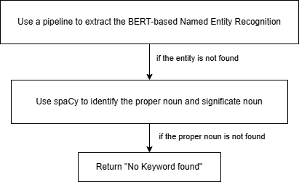
Further research - Stacked approach
Keyword identification on
original prompt (qm)
predicted output (a1)
CHENG Kit Shun

Slide 37
Further research - Stacked approach
: previous target
: new target
Example:
prompt = 'What is the capital of Japan?’ Predicted = “ The capital of Japan is Tokyo.”
Remark: the token that appears in the original prompt will be skipped in the predicted output when finding keyword
CHENG Kit Shun

Slide 38
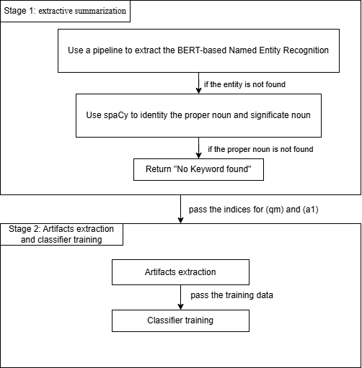
Further research
Stacked approach
CHENG Kit Shun

Slide 39
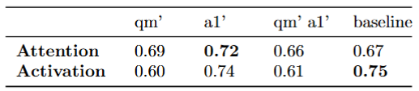
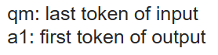
Further research - Stacked approach
qm’: use the new approach for qm
a1’: use the new approach for a1
CHENG Kit Shun

Slide 40
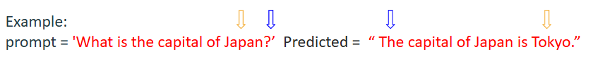
Analysis for Stacked approach
Self-attention score: significant enhancement
Due to the location-sensitive nature
Why performance drop when using qm’?
Attention dilution
Fully-connected activation scores: no improvement
Less sensitive to the specific token interactions
CHENG Kit Shun

Slide 41
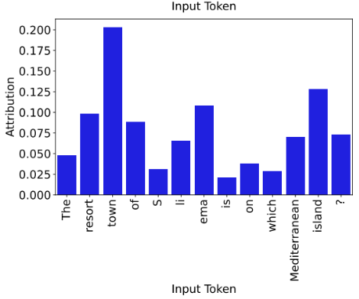
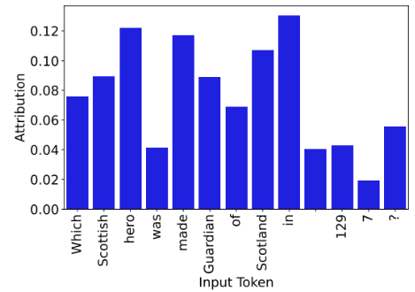
Feature attributions (Integrated Gradients)
Measure how important a feature (token) was towards a prediction
The authors posit that when answering the questions correctly, the model would focus on few input token only
Non-hallucinated
Hallucinated
Mok Ka Ho

Slide 42
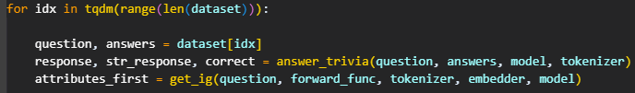
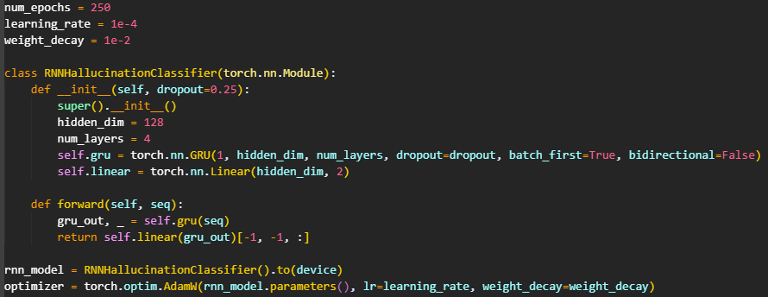
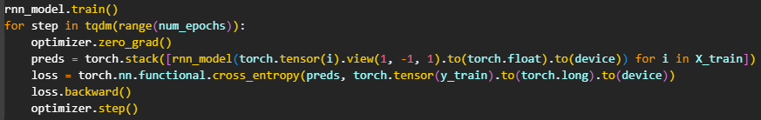
Feature attributions (Integrated Gradients)
Collected the response of LLM model and also the feature attributions for 9000 questions in TriviaQA
Trained a RNN classifier using the artifacts collected, with 250 epochs
Mok Ka Ho

Slide 43
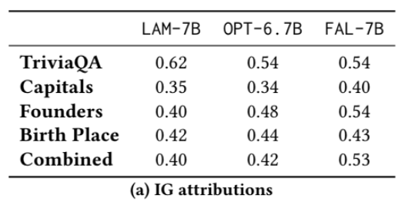
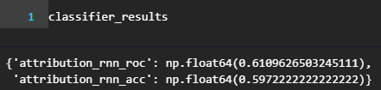
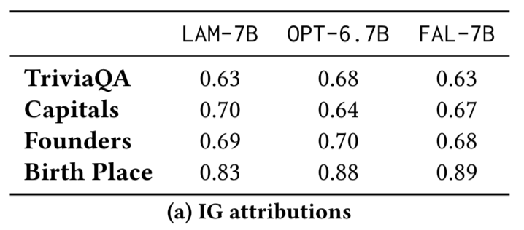
Feature attributions (Integrated Gradients)
AUROC: 61% (-1% with the paper)
Acc: 60% (-3% with the paper)
Author’s result
AUROC
Accuracy
Mok Ka Ho

Slide 44
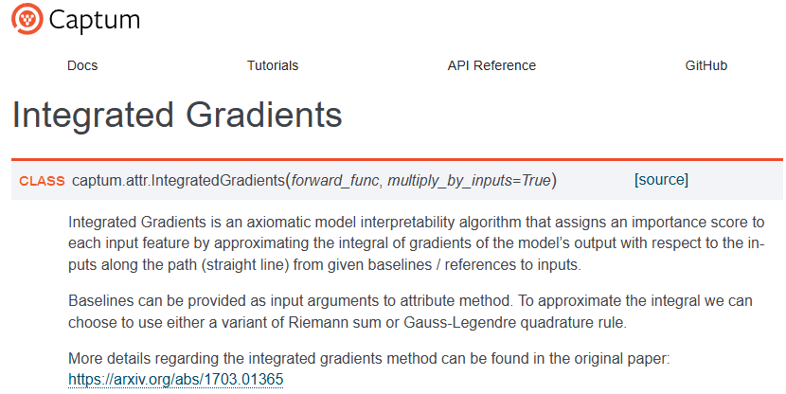
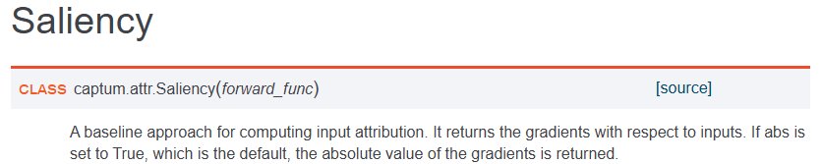
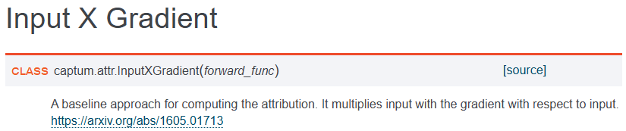
Feature attributions
Integrated Gradients takes ~15 seconds generate the attributions for each question
Explore computationally efficient alternatives which are also from Captum library (Same library for IG),
Saliency
Input X Gradient
which both of them should be significantly faster methods since they rely only on a single backward pass through the model to approximate feature attributions
Mok Ka Ho

Slide 45
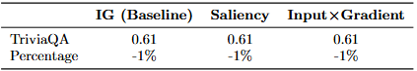
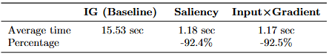
Feature attributions
(IG vs. Saliency vs. Input X Gradient)
Author’s result
Classifier performance (AUROC)
Process time per each question
Mok Ka Ho

Slide 46
Reducing Hallucinations (Research)
Mok Ka Ho

Slide 47
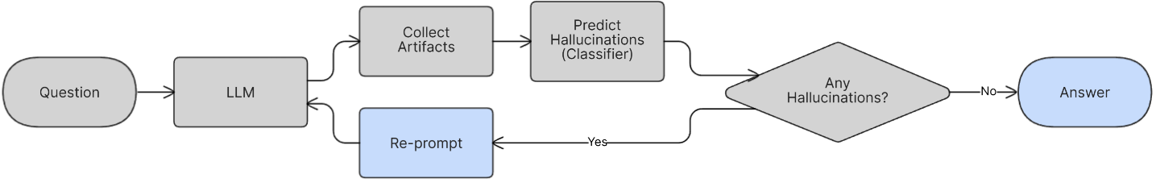
Methodology:
Classifier-Guided Recursive Prompting
We will utilize the hallucination detection classifiers we trained in implementation as a pre-output screener to determine if an output could be hallucinating
If the classifier predicted that the response is hallucinated
We will re-prompt the LLM, collect artifacts and predict again, using the classifier for n generations
Mok Ka Ho

Slide 48
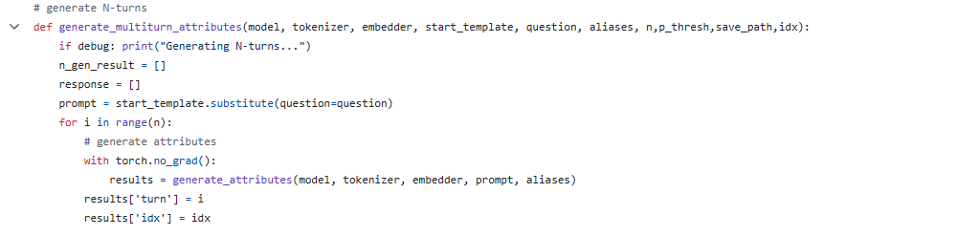
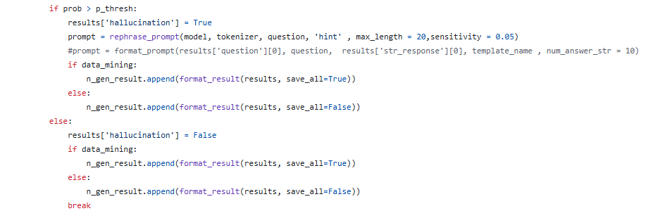
Pipeline Implementation
Key component 1:
Multi-turn Generation Engine: Manages the conversation flow between the question and model responses across multiple turns.
Collect Artifacts
⋮
Re-prompt if hallucinated
Break the loop if not hallucinated
Cheuk Sau AU

Slide 49
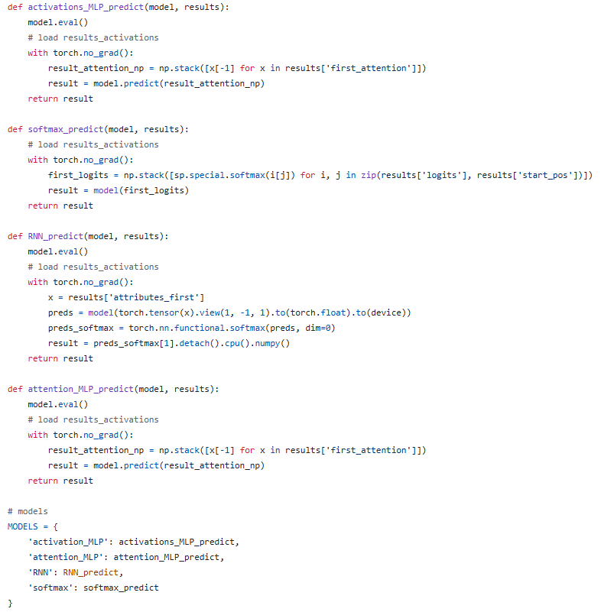
Pipeline Implementation
Key component 2:
Hallucination Detection System: Employs an classifiers to identify potential hallucinations in model outputs.
Selected classifier for development:
RNN Classifier on result IG values
P_threshold, hallucination if predicted probability > P_threshold
Cheuk Sau AU

Slide 50
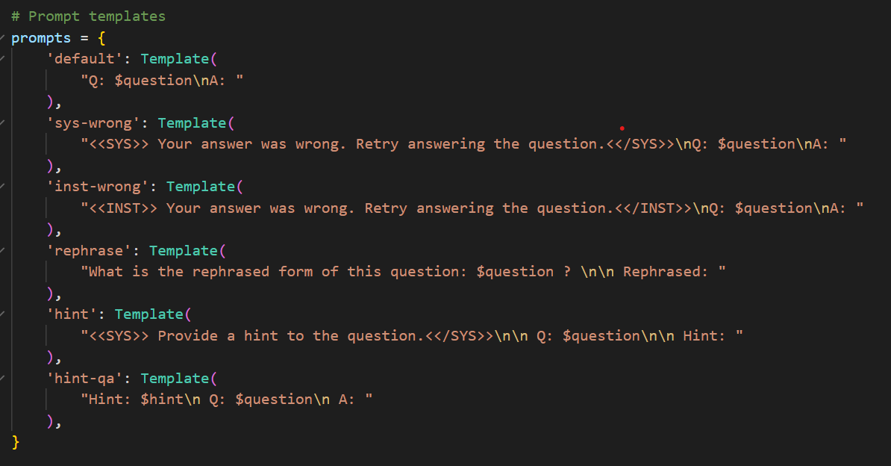
Pipeline Implementation
Dynamic prompt generation:
Hint regeneration
Question Rephrasing
Sensitivity-tuned hint prefix
Challenges occurred:
Open-Llama-7B was originally trained on question & answering data
Limited instruction tuning capabilities
Selected
Cheuk Sau Au

Slide 51
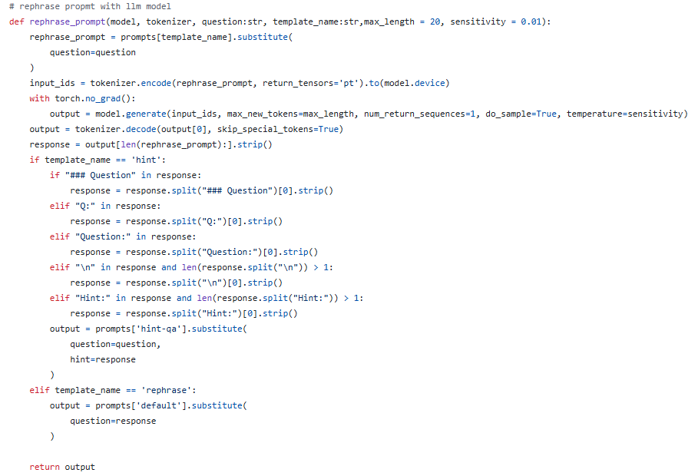
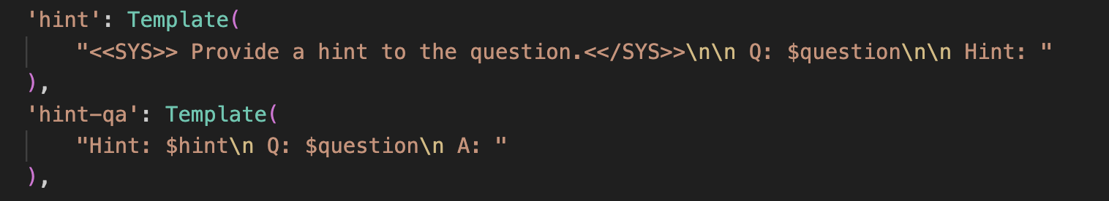
Pipeline Implementation
Key component 3:
Dynamic Prompt Reformulation: Automatically rephrases queries when hallucinations are detected.
If Hallucinating:
Regenerate a “Hint” at lower temperature (i.e. 0.05)
Regeneration of prompting for LLM for re-classification
Cheuk Sau Au

Slide 52
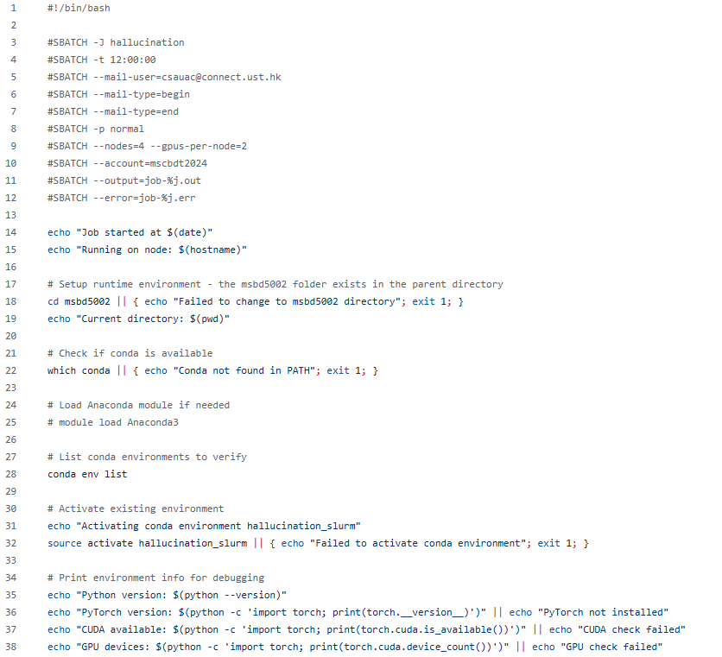
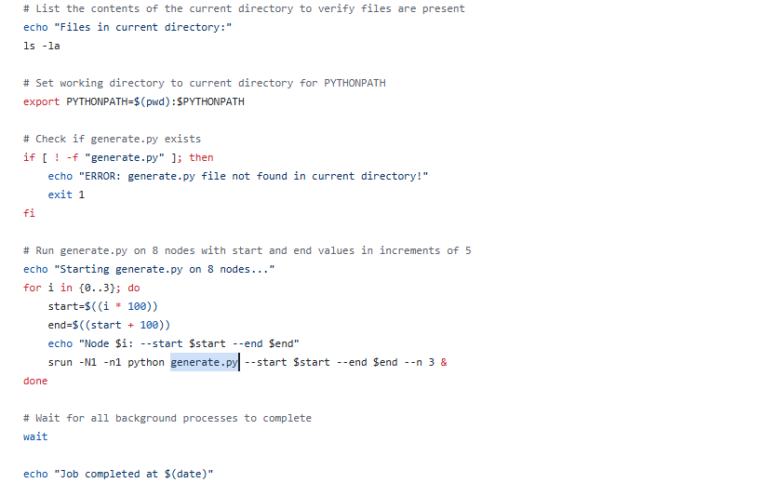
Parallelization of Recursive Generative Agent
Tool used: SuperPOD
Parallelized deployment of recursive multi-turn agents via data partitioning
Flags:
--start, --end, --sensitivity
Cheuk Sau Au

Slide 53
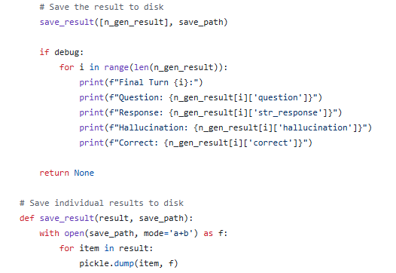
Pipeline Implementation
Key component 4:
Result Tracking and Storage: Captures comprehensive data about each interaction for analysis.
Optimized RAM: Improved RAM by streaming saved data into disk, reducing memory usage and improving scalability
Cheuk Sau Au

Slide 54
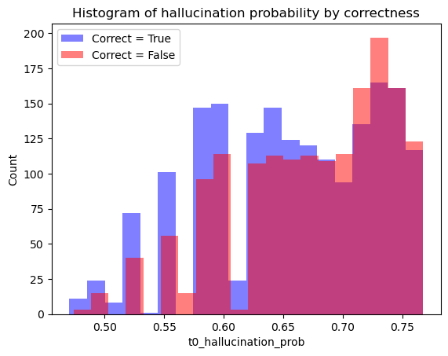

Pipeline Implementation - Result
RNN classifier (Feature attribution) ineffective at predicting
Mok Ka Ho

Slide 55


Pipeline Implementation - Result
RNN classifier (Feature attribution) ineffective at predicting
Generated Data is also highly skewed when predicted with classifier
Low Accuracy Score:
0.47851
Low ROC AUC Score:
0.5876
Mok Ka Ho

Slide 56

Pipeline Implementation - Result
Pipeline Implementation - Result
Dynamic prompting improves the results if the hallucination classifier is accurate. *
*This data here now assumes classifier is 100% accurate, which is not true to real environment. We expect a classifier to achieve close to 70%, similar to the implementation in original paper
Mok Ka Ho

Slide 57




Case study 1:
Correct & Not Detected Hallucination
Turn 0
Question:
'Q: Who won Super Bowl XX?\nA: '
Response:
'The Chicago Bears defeated the New England Patriots 24-10.\n'
Ground Truth: True
Classifier prediction: 0.473346
Cheuk Sau Au

Slide 58
Case study 2:
Recursive Generation: Detection & Correction
Turn 0
Turn 1
Question:
'Q: In which decade of the 20th century was Billy Crystal born?\nA: '
Sensitivity-Tuned Prefix
Question:
Hint: Billy Crystal was born in 1948.\n Q: In which decade of the 20th century was Billy Crystal born?\n A: '
Response:
'In the 1950s.\n'
Response:
'In the 1940s.\n'
Ground Truth:
False
Classifier prediction: 0.6760818
Ground Truth:
True
Classifier prediction: 0.7569113969802856
Cheuk Sau Au
Notes:
(An example that LLM responded a wrong answer at first & classifier predicted 1, and classifier predicted 0 in second turn, then responded a correct ans)
Question:
Ground Truth:
Classifier: predicted 1 (hallucinated)
Response: (Expected to be a wrong answer)

Slide 59

Case study 3:
BUT wrongly classifying CORRECT could lead to WRONG answer
Turn 0
Turn 1
Question:
'Q: In Greek mythology, who was the goddess of the rainbow?\nA: '
Wrong hint
Question:
'Hint: She was the daughter of Zeus and Hera.\n Q: In Greek mythology, who was the goddess of the rainbow?\n A: '
Response:
'Iris.’
Response:
'Aurora'
Ground Truth:
True (along with some hallucinating questions)
Classifier prediction: 0.623903
Enhancement for more predictable classifier in future work
Ground Truth:
False
Classifier prediction: 0.7569113969802856
Cheuk Sau Au
Notes:
(An example that LLM responded a wrong answer at first & classifier predicted 1, and classifier predicted 0 in second turn, then responded a correct ans)
Question:
Ground Truth:
Classifier: predicted 1 (hallucinated)
Response: (Expected to be a wrong answer)

Slide 60
Discussion/ Future Direction
Challenges:
Existing implemented model is only trained on Q&A tasks, very limited generative capabilities for instruction prompt.
Only used one single classifier
Classifier trained is not generalizable to other models, i.e. classifiers were unable to switch to instruct-llama model
Future Direction:
Implement pipeline using an instruct-trained model
Implement ensemble based classifier to improve accuracy of classifier
Explore more variations of prompts
Cheuk Sau Au

Slide 61
Reducing Hallucinations in LLMs via Prompting Strategies (Research II)
Tong Wai Lam

Slide 62

Method 1: Simple base prompt
A minimal system prompt designed to elicit concise, factual answers from LLMs
Encourages straightforward, accurate responses while minimizing computational overhead.
Tong Wai Lam

Slide 63


Method 2: Few-Shot Prompting
Includes a few example question-answer pairs before the target question to guide the LLM’s response.
Helps the model learn the desired response pattern in-context, improving factual accuracy by anchoring outputs to demonstrated correct answers.
William
Notes:
https://www.linkedin.com/pulse/few-shot-prompting-learning-fine-tuning-llms-aiyou-67-elias-a7u7e/

Slide 64

Method 3: Generated Knowledge Prompting
A two-stage prompting method where the LLM first generates relevant factual statements, then uses them to answer the question
Question:
'Elliot Carver is the villain in which James Bond film?'
Knowledge generated:
'Elliot Carver is the main antagonist in the 1997 James Bond film 'Tomorrow Never Dies'. \n\nHere are two more relevant facts:\n\n1. The film was directed by Roger Spottiswoode and starred Pierce Brosnan as James Bond.\n2. Elliot Carver, played by Jonathan Pryce, is a media mogul who manipulates global events for his own gain in the film.'
LLM final answer:
Elliot Carver is the villain in the 1997 James Bond film 'Tomorrow Never Dies'.
Tong Wai Lam
Notes:
https://www.linkedin.com/pulse/few-shot-prompting-learning-fine-tuning-llms-aiyou-67-elias-a7u7e/

Slide 65
Method 4: Chain-of-Knowledge Prompting
A multi-stage prompting strategy that simulates expert deliberation by synthesizing knowledge from relevant domains before answering
Stage 1: Create fields
-Identifies 3–4 relevant fields from the questions(e.g., climate science, energy policy).
Stage 2: Create knowledge
-Generate factual statements by considering perspectives from each expert fields generated in stage 1
Stage 3: QA response
-Based on output from stage 1 and 2 answer the question
Tong Wai Lam
Notes:
https://www.linkedin.com/pulse/few-shot-prompting-learning-fine-tuning-llms-aiyou-67-elias-a7u7e/

Slide 66
Method 4: Chain-of-Knowledge Prompting
E.g. question: "Kagoshima international airport is in which country?"
Stage 1: Create fields
"expert_fields": ["geography","Japan studies", "urban planning", "transportation engineering"]
Stage 2: Create knowledge
-"expert_knowledge": "**Expert Fields Consulted:**\n\n1. Geography\n2. Japan Studies\n3. Urban Planning and Transportation Engineering\n\n**Key Insights from Each Field:**\n\n1. **Geography**: Kagoshima International Airport is located in Kyushu, a southern island of Japan. According to the Japanese Ministry of Land, Infrastructure, Transport, and Tourism (2019), the airport's geographical coordinates are 31\u00b035\u2032N 130\u00b037\u2032E.\n2. **Japan Studies**: The airport serves as a major gateway to Kagoshima Prefecture, which is known for its natural beauty, including Sakurajima volcano. According to Japan National Tourism Organization (2020), Kagoshima International Airport is an important hub for tourism and trade in the region.\n3. **Urban Planning and Transportation Engineering**: The airport's design and infrastructure are aligned with Japan's urban planning principles, prioritizing efficiency, safety, and environmental sustainability. A study by the Japan Airports Corporation (2018) highlights the airport's capacity to handle increasing air traffic while minimizing its impact on the surrounding environment.\n\n**Consensus and Disagreements:**\n\nThere is consensus among all three fields that Kagoshima International Airport is located in Japan. However, there might be some disagreement regarding the exact classification of the airport as \"international\" versus \"domestic.\" According to the Japanese Ministry of Land, Infrastructure, Transport, and Tourism (2019), Kagoshima International Airport serves both domestic and international flights.\n\n**Synthesized Summary:**\n\nKagoshima International Airport is located in Japan, specifically on the southern island of Kyushu. The airport plays a crucial role in tourism and trade, with its design prioritizing efficiency, safety, and environmental sustainability. While there might be some nuance regarding the classification of the airport's international status, all expert fields agree that it is an important hub for air travel in Japan.\n\nReferences:\n\n* Japanese Ministry of Land, Infrastructure, Transport, and Tourism (2019). Airport Statistics 2018.\n* Japan National Tourism Organization (2020). Kagoshima Prefecture Tourist Information.\n* Japan Airports Corporation (2018). Sustainability Report 2017."
Stage 3: QA response
"According to experts in geography, Japan studies, and urban planning and transportation engineering, there is consensus that Kagoshima International Airport is located in Japan. The available expert knowledge suggests that it is situated on the southern island of Kyushu."
Tong Wai Lam
Notes:
https://www.linkedin.com/pulse/few-shot-prompting-learning-fine-tuning-llms-aiyou-67-elias-a7u7e/

Slide 67
LLMs and Temperature Settings
LLMs Used:
DeepSeek LLM 7B Base: Released December 2023, 7 billion parameters, designed for general-purpose language tasks
DeepSeek R1 Distill LLaMA 8B: Released January 2025, 8 billion parameters, distilled LLaMA with 128k token context and Chain-of-Thought fine-tuning.
LLaMA 3.2 3B Instruct: Released September 2024, 3 billion parameters, instruction-tuned for enhanced task-following
LLaMA 3.1 8B Instruct: Released July 2024, 8 billion parameters, balances efficiency and performance.
Temperature Settings:
Adjusted to 0.1, 0.2, and 0.6. Lower values (0.1) prioritize deterministic, factual outputs; higher values (0.6) increase randomness for diverse responses.
Tong Wai Lam

Slide 68



Result Analysis
Tong Wai Lam

Slide 69
Result Analysis (Key takeaways)
Prompting Methods and Temperature Effects
Few-Shot Prompting Best: Achieves highest accuracy, significantly outperforming other methods, with low resource use (24.1 tokens/question). Ideal for efficient, accurate deployment
Generated Knowledge Prompting: Nearly matches Few-Shot’s accuracy but requires 8x more tokens (163.76 tokens/question), making it less practical due to high generation time and content demands.
Simple Base Prompt: Strong baseline, surpassing zero-prompt setups, offering decent accuracy with minimal overhead (11.8–16 tokens/question)
Temperature Stability with Few-Shot: Maintains consistent accuracy (67%) across temperature range (0.1–0.6), unlike other methods. In-context examples reduce sensitivity to parameter changes, enhancing robustness for real-world use.
Tong Wai Lam

Slide 70
Result Analysis (Key takeaways)
Choice of LLM: Size vs. Recency
Larger Models Generally Better: LLaMA 3.1 8B (67% accuracy) outperforms LLaMA 3.2 3B (53%), showing higher parameter counts often improve performance
Newer Models Outperform Older Ones: LLaMA 3.2 3B (Sep 2024, 53%) beats DeepSeek 7B (Dec 2023, 41%) despite 57% fewer parameters, due to advanced instruction-tuning and optimized architectures
Model recency and architectural advancements often surpass parameter scale. Newer, smaller models leverage architectural improvements to achieve better accuracy-efficiency trade-offs, critical for resource-constrained environments
Tong Wai Lam

Slide 71

Thanks!

